Slide 1
Project 1
The Effect of Air Pollution and Smoking on
Cancer and Stroke Incidence Rates
Group Members:
Emrah Selli
James Jang
Joel Timulak
Olga Taranukha
Paul Stephens
Petra Lee
Northwestern Data Science Bootcamp
Wednesday, July 9, 2019

Slide 2
Project Question and Motivation
Purpose
To explore the relationship between air pollution/smoking and disease incidence rates in the United States per county
Smoking
Types of Air Pollution
Diseases
NO2; SO2; O3;
Black Carbon; Air Quality Index (AQI)
Good; Moderate; Unhealthy for Sensitive Groups; Unhealthy; Very Unhealthy; Hazardous
Lung Cancer; Skin Cancer; Blood Cancer
Stroke

Slide 3
Data for our Project
United States Environmental Protection Agency
Centers for Disease Control and Prevention
Annual AQI by County (2011-2015)
Smoking Data by State (2011 -2015)
1
United States Cancer Statistics (USCS)
Lung Cancer Incidence Rate per County
Skin Cancer Incidence Rate per County
Blood Cancer Incidence Rate per County
Stroke Incidence Rate per County
Final DataFrame Columns
2
['County', 'Days with AQI', 'Good Days', 'Moderate Days', 'Unhealthy for Sensitive Groups Days', 'Unhealthy Days', 'Very Unhealthy Days', 'Hazardous Days', 'Max AQI', '90th Percentile AQI', 'Median AQI', 'Days CO', 'Days NO2', 'Days Ozone', 'Days SO2', 'Days PM2.5', 'Days PM10', 'Skin_IR', 'Lung_IR', 'Blood_IR']
3

Slide 4
Data Exploration and Cleanup Process
We split cells to equalize the columns to be grouped using the groupby function
We merged csv files on county or state names
Re-arranged data and column headings
Removed unnecessary data and unusual characters
Re-formatted data to allow numerical analysis

Slide 5
Analysis Process
Created charts to see relationships using Matplotlib and Seaborn
Ran correlation tables to get summary statistics
Considered previous research

Slide 6
Visualizations

Slide 7
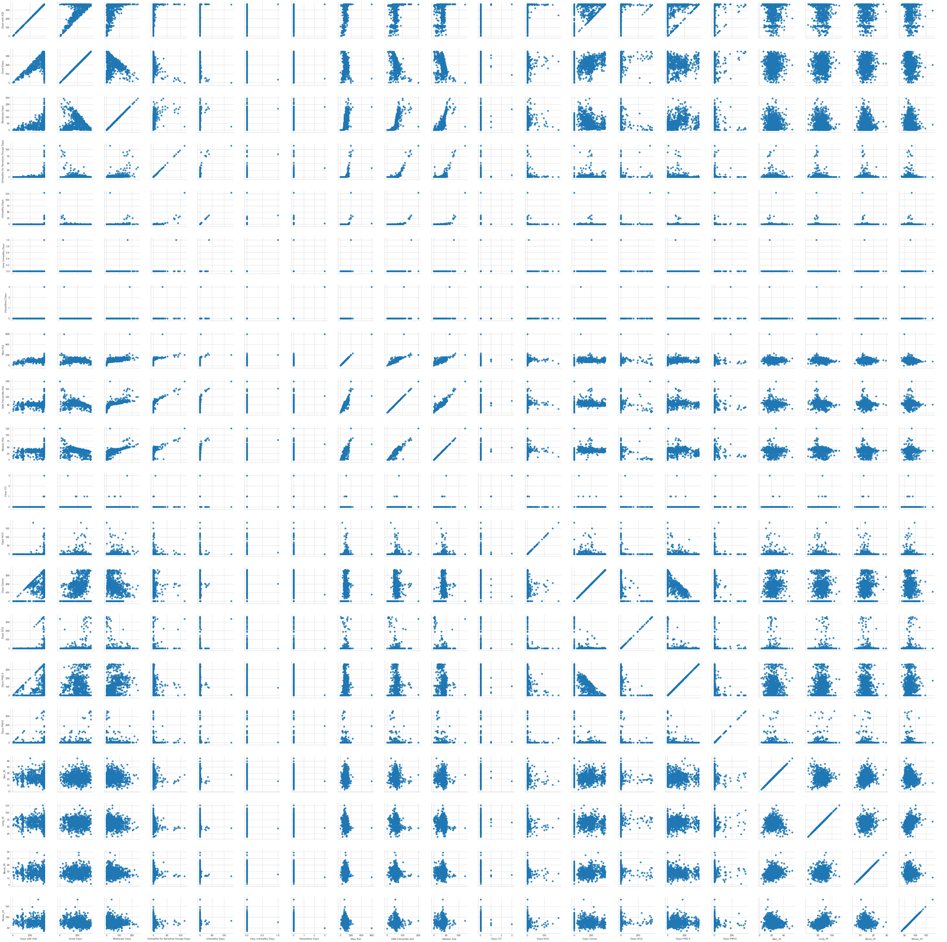

Slide 8
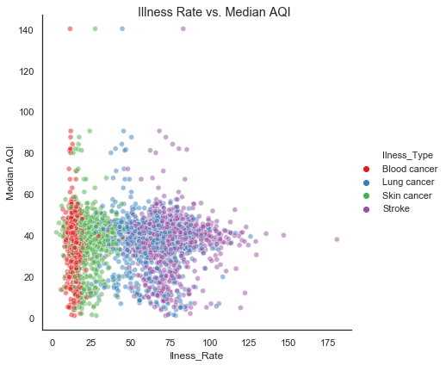

Slide 9
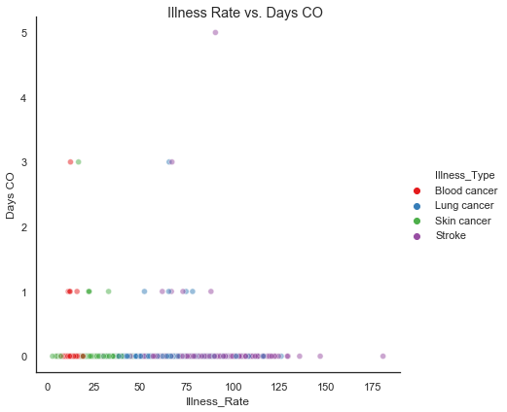

Slide 10
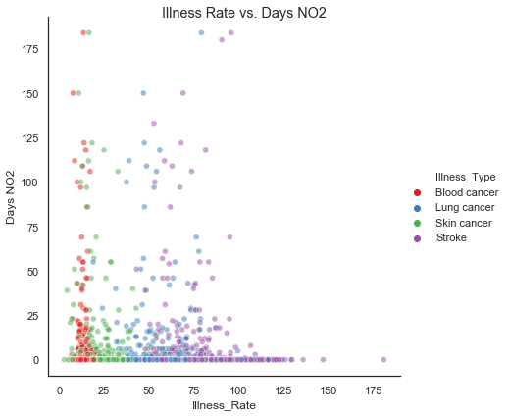

Slide 11
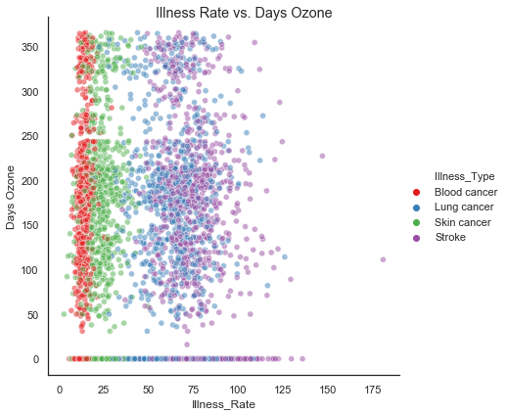

Slide 12
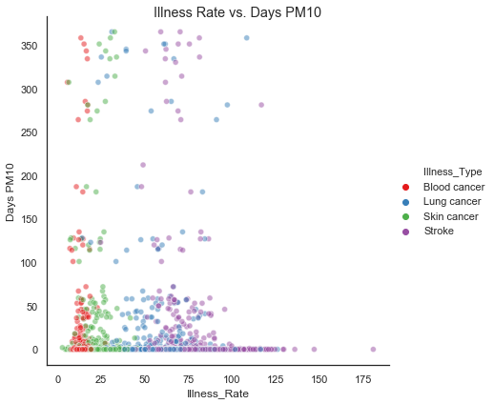

Slide 13
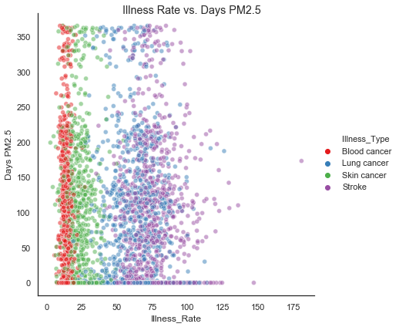

Slide 14
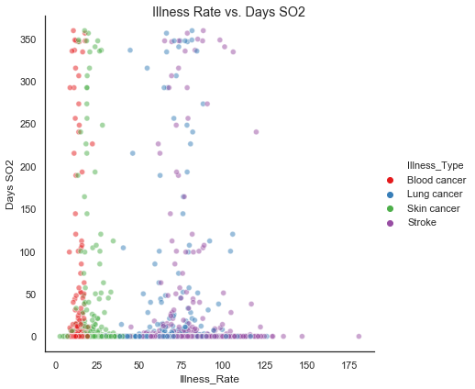

Slide 15
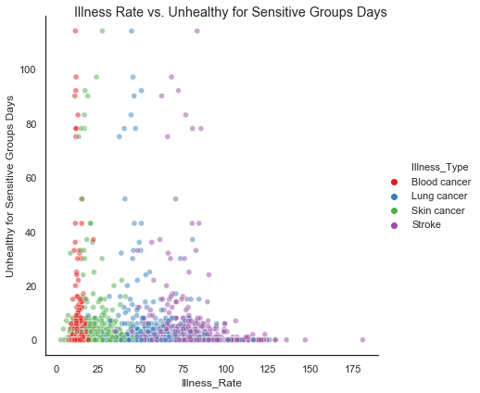

Slide 16
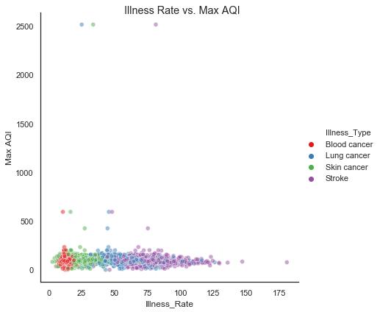

Slide 17
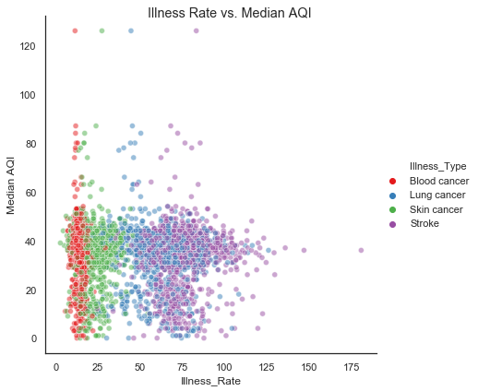

Slide 18
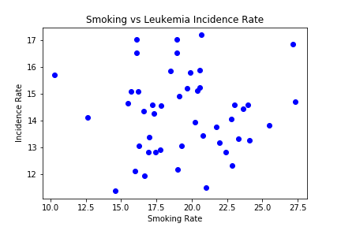

Slide 19
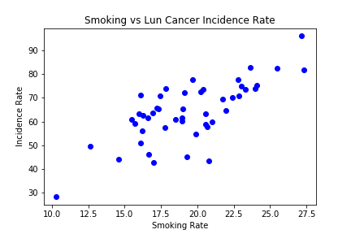

Slide 20
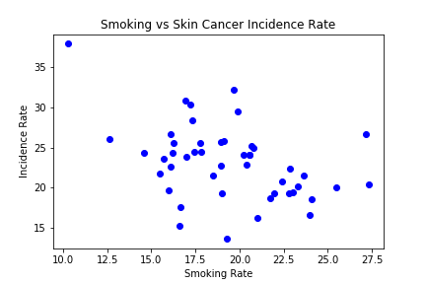
Oddly, smokers don't seem to be at increased risk for melanoma. In fact, some studies have suggested they might even have a smaller chance of getting the disease -- although scientists are still trying to figure out if that's really true.
A paragraph from an article
Fox News

Slide 21
Conclusion
We did not see any strong relationships between air quality measures vs the cancer data nor the stroke data.
We did see a positive relationship between cigarette smoking and lung cancer.
We did see a weak negative correlation between melanoma and smoking
No correlation between smoking and leukemia

Slide 22
Limitations
For cancer and stroke data, we were limited to averages over a five year period. We converted 5 years of air quality data to an average of the same period.
Therefore, we were not able to observe trends.
Also, the five year period, 2011 through 2015, started over 40 years after creation of the US EPA.
Lastly, this limitation may not fully capture how the the development of cancer may require prolonged exposure to a certain carcinogen.
People changing locations can lead to a bias.
Genetic predispositions may also lead to a bias

Slide 23
Insights
Implications, Opportunities, and Strategy
Implications
Based on our research, the null hypothesis is accepted and a statistically significant correlation cannot be deduced
Opportunities
As cancer rates become recognized as the most common cause of death in the United States, gathering a more comprehensive data of our air and incidence rates is vital
Strategy
Years of residency, genetics, and a broader timeline must be considered in order to find potential correlations between pollution and cancer

Slide 24
Further Research Possibilities
Consider global data
Consider trends over time
Compare to existing research regarding potential links

